Slide 1
Pre Calculus 12 Ch1 Transformation REVIEW

Slide 2
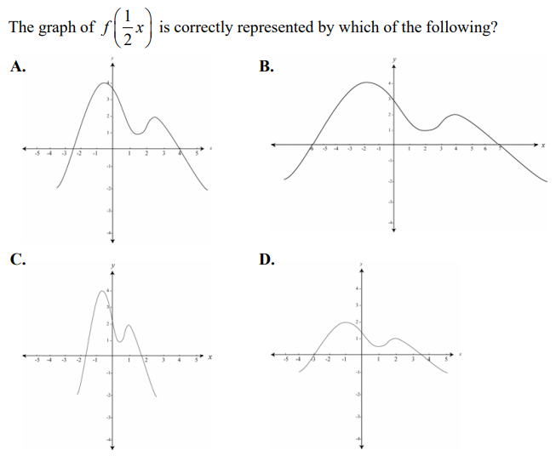
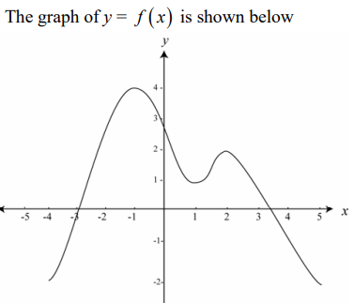

Slide 3
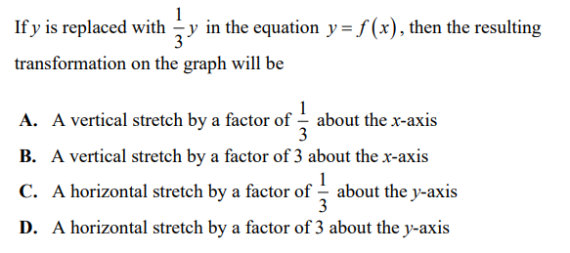

Slide 4
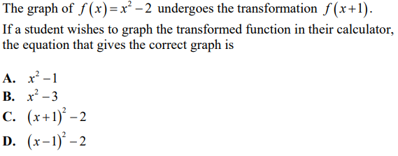

Slide 5


Slide 6


Slide 7
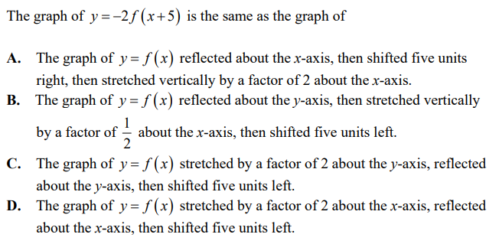

Slide 8
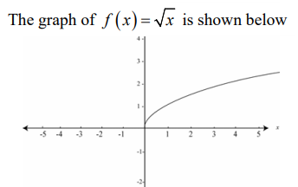
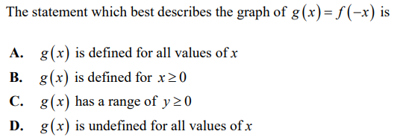

Slide 9
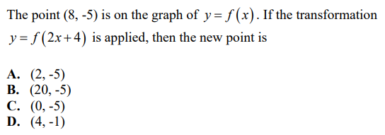

Slide 10
The following function will all undergo a horizontal expansion by a factor of 2. Which of the following is the correct equation after the transformation?

Slide 11
The following function will all undergo a horizontal expansion by a factor of 3. Which of the following is the correct equation after the transformation?

Slide 12


Slide 13


Slide 14


Slide 15
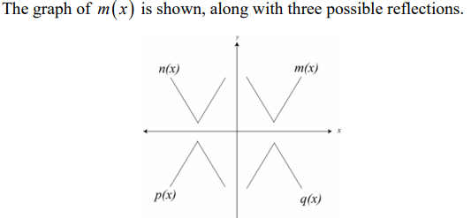

Which equation is n(x), p(x) , and q(x)??

Slide 16
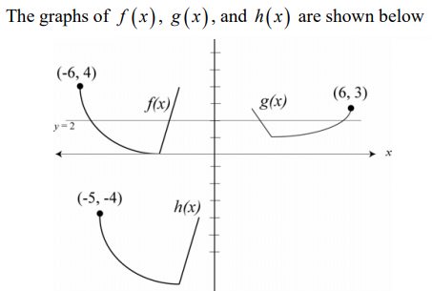
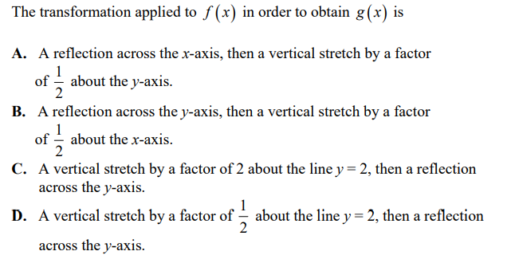

Slide 17
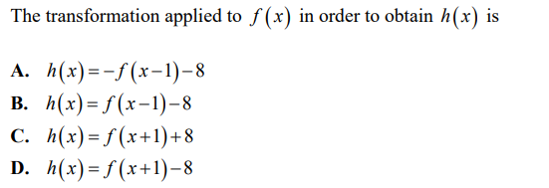

Slide 18
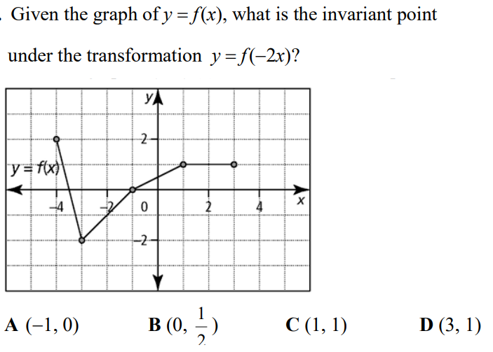

Slide 19
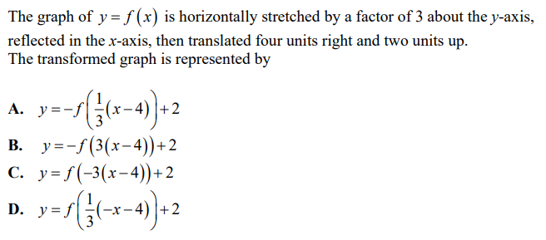

Slide 20


Slide 21
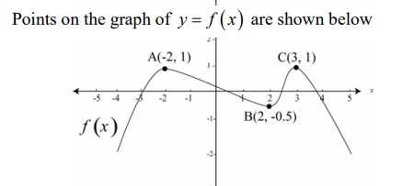


Slide 22


Slide 23


Slide 24
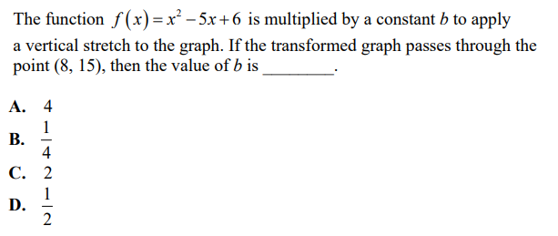

Slide 26
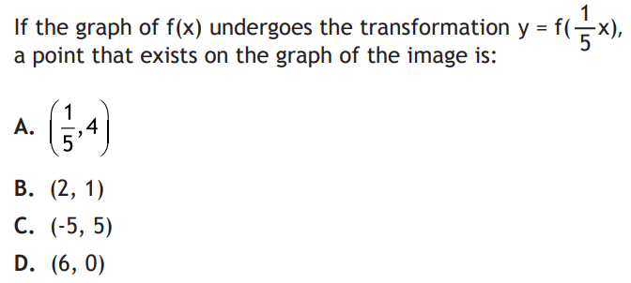
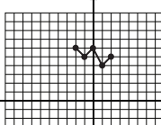

Slide 27
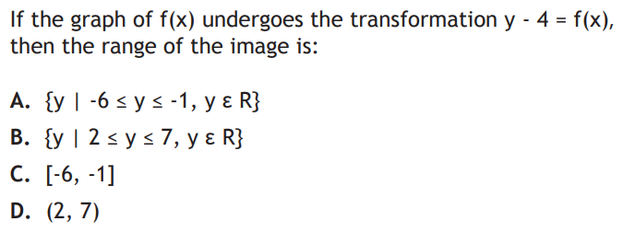


Slide 29
